Slide 1

5G Mobile Network

Slide 2
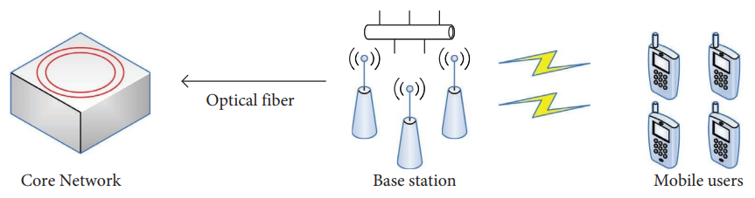
Overview of 5G Mobile Communication Technology
As an improvement and upgrade of 4G technology, it provides more convenient and fast mobile communication services for human society. The basic three components: UE, BS and Core Network (CN) are same like previous generations.
Fig.1 5G mobile communication technology basic structure

Slide 3
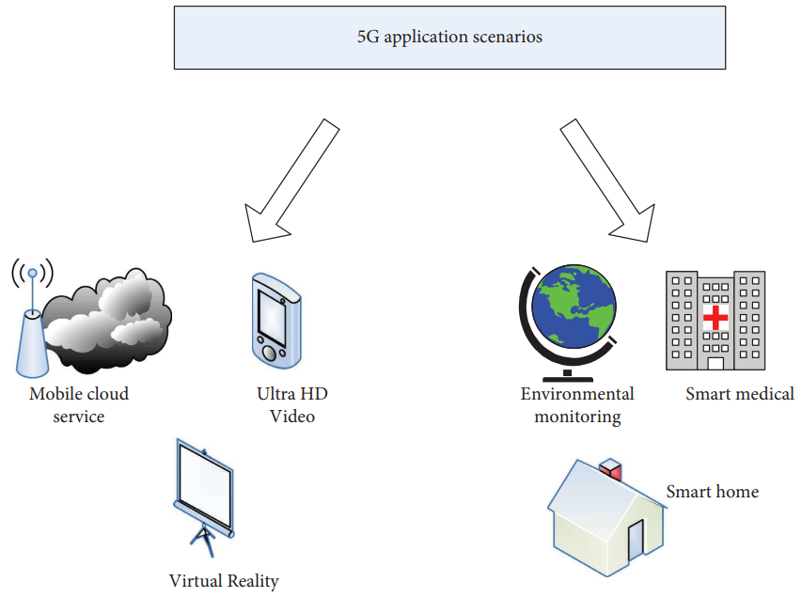
The network offers faster data transmission, lower latency, and greater reliability compared to previous generations.
Ultra-High Definition (UHD) refers to displays capable of displaying images with a resolution between 3840 by 2160 pixels up to 4096 by 3112 pixels.

Slide 4
Why 5G?
Wireless system designers have been facing the difficulties as:
Increasing demand for high data rates
Mobility required by new wireless applications (for example
femtocell mobility)
The requirement of heterogeneous wireless devices
Wide-ranging applications on extremely dense urban
Above situation cannot be easily handled by 4G systems, because of inefficient use of the frequency spectrum (below 5GHz like 1G to 4G) and the high energy consumption.
Therefore research started on fifth generation wireless systems that are expected to be deployed beyond 2020.

Slide 5
2. Basic Parameters of 5G (IMT 2022)
The main objective of 5G is to support the mobile data traffic at extremely high speed. Data rate can be measured in several different ways:
Aggregate data rate refers to the total amount of data the network can serve, characterized in units of bits/s/area. It indicates the density of throughput in service area. The increased in data rate will be roughly 1000x from 4G to 5G.
Edge rate, or 5% rate, is the worst data rate (at the cell boarder or edge) that a user can reasonably expect to receive when in range of the network. Goals for the 5G edge rate range from 100 Mbps to 1 Gbps.

Slide 6
Latency: 5G will need to be able to support a roundtrip latency of about 1 ms, where current 4G roundtrip latencies are on the order of about 15 ms.
Energy and Cost: As we move to 5G, costs and energy consumption will, ideally, decrease, but at least they should not increase on a per-link basis. Since the per-link data rates being offered will be increasing by about 100x, this means that the Joules per bit and cost per bit (in context of call charge) will need to fall by at least 100x. Since the size of a cell is smaller then it is more power efficient than macrocells.
Complete wireless communication with minimum limitation and highly supportable to WWWW (Wireless World Wide Web).

Slide 7
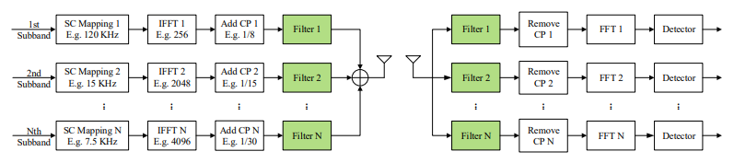
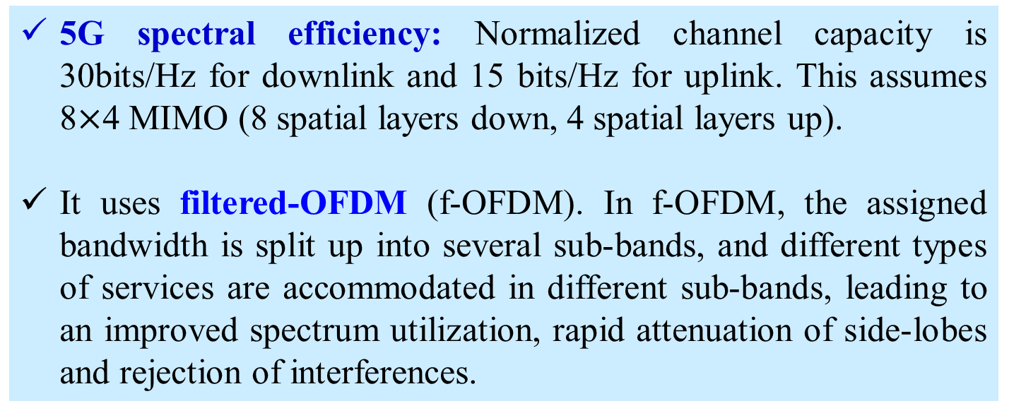
5G spectral efficiency: Normalized channel capacity is 30bits/Hz for downlink and 15 bits/Hz for uplink. This assumes 8$×$4 MIMO (8 spatial layers down, 4 spatial layers up).
It uses filtered-OFDM (f-OFDM). In f-OFDM, the assigned bandwidth is split up into several sub-bands, and different types of services are accommodated in different sub-bands, leading to an improved spectrum utilization, rapid attenuation of side-lobes and rejection of interferences.

Slide 8
A major cost consideration for 5G, even more so than in 4G due to the new BS densities and increased bandwidth, is the backhaul from the network edges into the core.
Frequent handover of users, hence huge reserve BW is essential for each BS to protect Handover Failure.

Slide 9
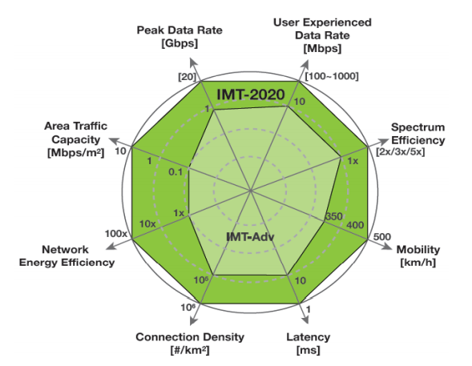
Normalized capacity
bits/Hz
Relative performance of 4G (IMT-Advanced) and 5G (IMT 2020)

Slide 10
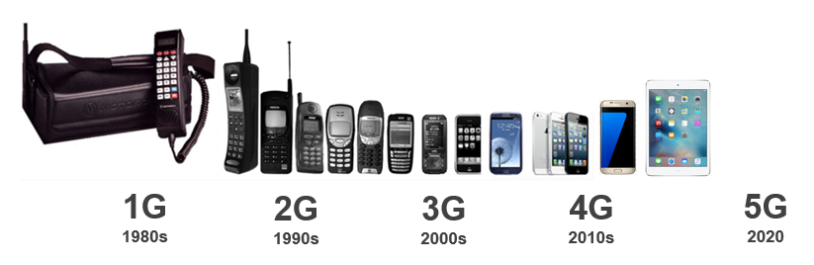
What is 5G?
5G is the 5th generation of mobile networks
Extreme speeds - Gbps
High Capacity – 10x
Low Latency – 1ms
Analogue
Digital
SMS
Multimedia
Video Calling
Mobile internet
Mobile Broadband
Enhanced Video
Mobile Connected World
Enhanced Mobile Broadband
Low latency applications
Internet of Things
Augmented and Virtual Reality (AR & VR)
10

Slide 11
3. EU project METIS

Slide 12

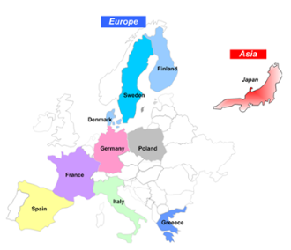
The EU project METIS which stands for Mobile and wireless communications Enablers for the Twenty-twenty Information Society.
The main objective of the project is to lay the foundation of 5G as the next generation mobile and wireless communications system. The project consortium consists of 25 partners representing vendors, operators, academic institutions, and the automotive industry.
Vendors: Alcatel-Lucent, Ericsson, Huawei, Nokia, NSN
Operators: Deutsche Telekom, DOCOMO, Orange, Telecom Italia, Telefonica
Automobile industry: BMW
Academic organization: AAU, Aalto, CTH, HHI, TB, ….
Test and measurement vendors: Anite
https://metis2020.com/about-metis/partners/index.html

Slide 13



World Radiocommunication Conferences (WRC)
World Radio Communication Conferences (WRC) are held every three to four years. It is the job of WRC to review and revise of Radio Regulations. Revisions are made on the basis of an agenda determined by the ITU Council, which takes into account recommendations made by previous world radiocommunication conferences.
Exploratory research
Pre-standardization activities
Standardization activities
Commercialization
2012
2013
2014
2015
2016
2017
2018
2019
2020
WRC’12
WRC’15
WRC’18/19
World Radio Communication Conference (WRC) of 5G

Slide 14

The METIS-II builds on the successful METIS project and will develop the overall 5G radio access network design.
Key objectives of METIS-II are to develop the overall 5G radio access network design and to provide efficient integration and use of the various 5G technologies and components currently developed.
It includes partners from all regions with strong 5G R&D initiatives (EU, US, China, Japan, Korea).

Slide 15


METIS Technical Objectives
1000x data volume
50/500 B devices
Up to 10Gbps
Few ms E2E
10 years
1000x higher mobile data volumes
10-100x higher number of connected devices
10-100x typical end-user data rates
5x lower latency
10x longer battery life for low-power devices
The advent of the Internet of Things and its applications, a wide verity of connected devices require wireless connectivity
Notes:
5G/METIS
2013-07-19
© Ericsson AB 2013
15

Slide 16
5G Future
Evolution
D2D Communications
and / or
and / or
Revolution
Complementary new technologies
Massive MIMO
M2M Communications
Ultra-DenseNetworks
Extend to novel applications
Moving Networks
Respond to traffic explosion
Ultra-Reliable Communications
Higher Frequencies
10X battery life
Existing technologies in 2012
3G
Wifi
4G
Notes:
Increase the fonts

Slide 17
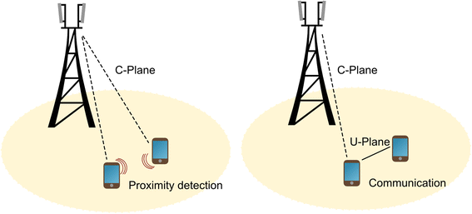
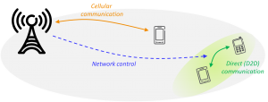
Following services are integrated under MEITS
A. Device-to-Device (D2D)
Direct D2D Communication refers to direct communication between devices, without routing the data paths through any network infrastructure. A direct link without routing via Evolved Node B (eNB) and possibly Core Network (CN). In the D2D communication BSs do not have any more the overall control, but the control is at some extent moved to UEs.
The goals are to increase spectral efficiency, improved typical user data rate and capacity per area, extended coverage, reduced latency, and enhanced power efficiency.

Slide 18
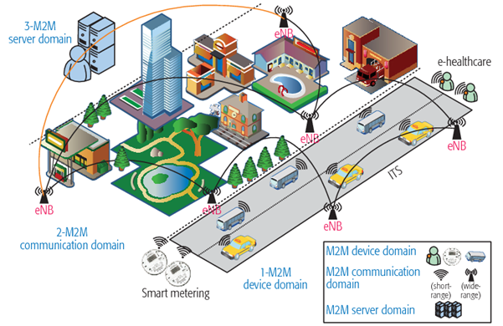
B. Machine to Machine (M2M) Communication
In Machine-to-Machine Communication, the devices of wireless ad-hoc networks are embedded with machines as the nodes of communication systems. They allow them to communicate autonomously with each other without human intervention. Few examples of M2M communication of 5G is given below.
Cars or Vehicles are also machines. In cases of M2M they are able to communicate with each other, if they share the same network. Intelligent Transport Systems that, for example, will provide cars and buses with information about road traffic or accidents ahead.

Slide 19
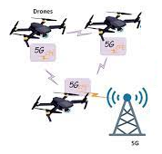
Another use for communicating devices is for industrial applications. This can be used for remote control of heavy machinery in remote or hazardous places.
A fleet of drones (flying robots) equipped with sensors and intelligent algorithms can be used as WSN. A drone could learn a new route and instantly teach it to other drones of the fleet. They could as well exchange environmental information like weather, air-pressure or humidity.

Slide 20
D. Moving Networks (MN)
A moving network node for example MFemtocell (Mobile Femtocell) is a small cell that can move around and dynamically change its connection to an operator’s core network.
It can be deployed on public transport buses, trains, and even private cars to enhance service quality to users within vehicles.
Access point (or BS) of the MFemtocell is located inside vehicles to communicate with users within the vehicle, while large antenna arrays are located outside the vehicle to communicate with outdoor BSs. An MFemtocell and its associated users are all viewed as a single unit to the BS. From the user point of view, an MFemtocell is seen as a regular BS.

Slide 21
MFemtocells can contribute to signaling overhead reduction of the network. For instance, an MFemtocell can perform a handover on behalf of all its associated users, which can reduce the handover activities for users within the MFemtocell. This makes the deployment of MFemtocells suitable for high-mobility environments.
In addition, the energy consumption of users inside an MFemtocell can be reduced due to relatively shorter communication range and low signaling overhead.

Slide 22
E. Ultra-dense Networks (UDN)
Ultra-Dense Networks (UDN) refers to an access node densification far beyond today’s networks.
A straightforward but extremely effective way to increase the network capacity is to make the cells smaller.
Cell shrinking has numerous benefits, the most important being the reuse of spectrum across a geographic area and the ensuing reduction in the number of users competing for resources at each BS.
Difficult to support mobility of users against frequent handoff and installation cost.

Slide 23
F. Ultra-reliable Networks (URN)
Ultra-Reliable Communication (URC) refers to solutions that will enable high degrees of reliability and availability. It is required to provide scalable and cost-efficient solutions for networks supporting services with extreme requirements on availability and reliability.
Reliable service decomposition provides mechanisms for graceful degradation of rate and increase of latency, instead of dropped connections, as the number of users increases.

Slide 24
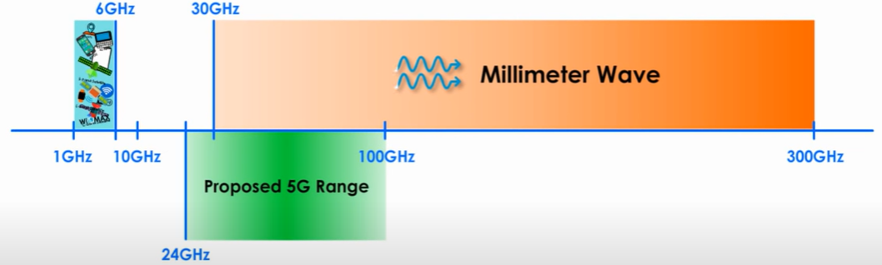
G. Millimeter Wave
The frequency band 1GHz to 6GHz is very crowdy since this band is used by WiMAX, GPS, Wi-Fi, 4G, 3G, L band, S band, C band of satellite etc.
Fortunately, vast amounts of relatively idle spectrum do exist in the mm Wave range of 30– 300 GHz, where wavelengths are 1–10 mm as shown above.
It is new and less used band.
Higher frequency wave carries more data than low frequency wave i.e. bits/Hz (spectral efficiency) is higher.
Millimeter wave makes it possible to implement massive MIMO since size of antenna element and their separation is lower therefore large number of antenna elements can be accommodate on the array antenna panel called massive MIMO.

Slide 25
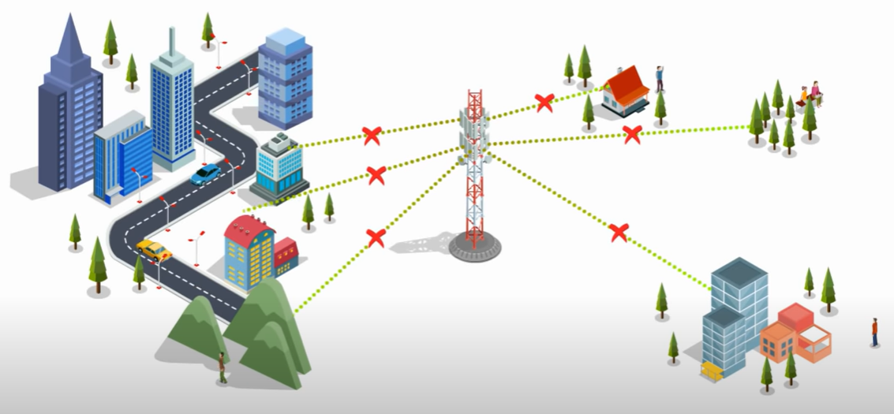
Millimeter wave has some drawbacks like, hostile propagation qualities, including strong pathloss, atmospheric and rain absorption, low diffraction around obstacles and penetration through objects and exorbitant equipment costs.
Signal of mm wave is interrupted by obstacle more severely.

Slide 26
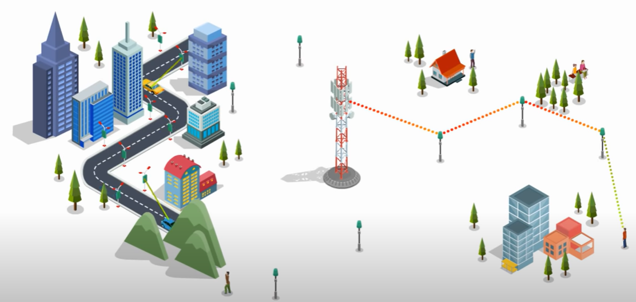
Small cell stations are introduced to fill the coverage gap between UE and BS, where each cell station covers small area. Usually its coverage radius varies from 10 to 100 meters.

Slide 27
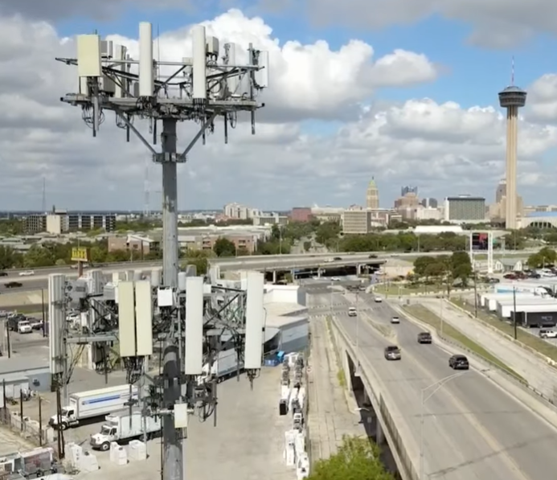
Users are very closed to high intense radiation hence has impact on human health.

Slide 28
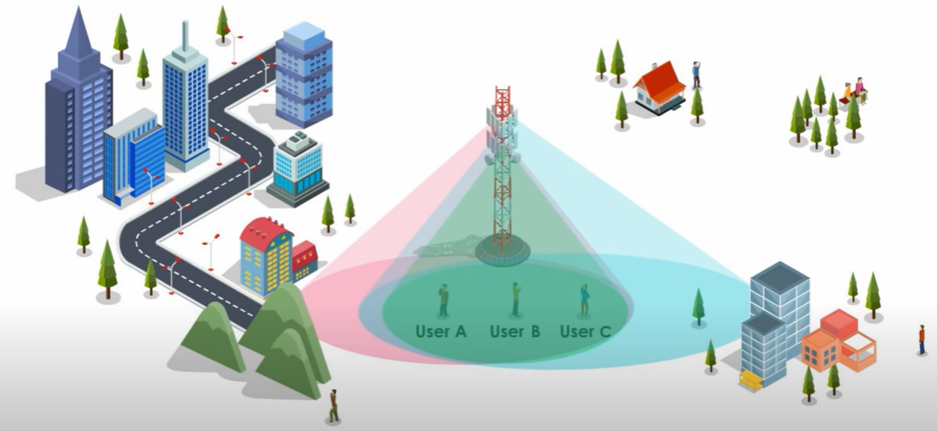
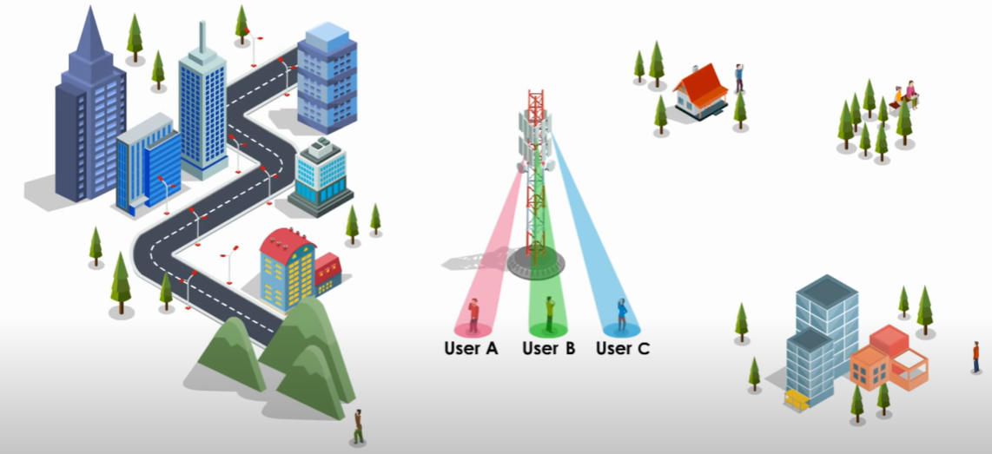
H. Massive MIMO in Beamforming
For massive MIMO systems, beamforming helps with increasing spectrum efficiency, and for millimeter waves, it helps in boosting data rate.
Since the millimeter waves cannot penetrate through obstacles and do not propagate to longer distances due to a shorter wavelength, beamforming here helps to send concentrated beams towards the users. Thus, beamforming helps a user to receive a strong signal without interference with other users.
Omni directional beam
Directional beam with MIMO

Slide 29
Linear array antenna system (AAS)
Circular array antenna system (AAS)
Rectangular array antenna system (AAS)

Slide 30
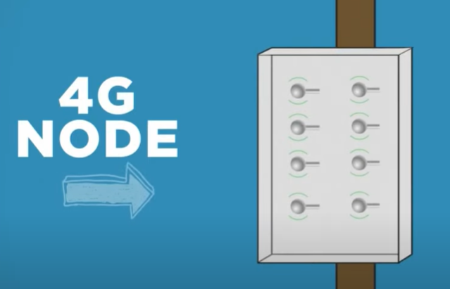
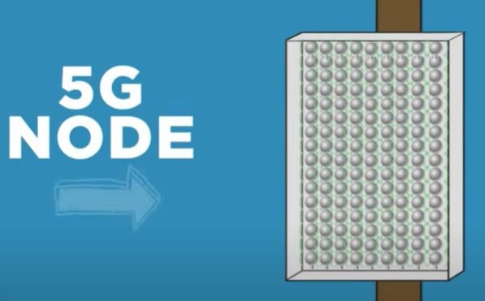
In 4G, 8 antenna elements in an array.
In 5G, more than 100 antenna elements in an array.

Slide 31
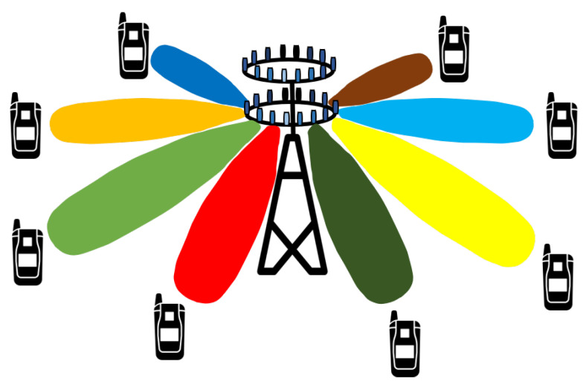
Beam-steering technology has also been adopted to enable the transmitter and receiver antenna beams to be focused towards the mobiles with which they are communicating. Using adaptive algorithm a focused beam can track an user while moving.

Slide 32
Beam-steering is a technique used in modern wireless communication systems (like 5G, Wi-Fi 6, and satellite communications) where the direction of the antenna’s radiation pattern is electronically controlled instead of physically moving the antenna.
Traditional antennas radiate signals in all directions (omnidirectional).
Beam-steering antennas use phased arrays or other techniques to concentrate energy in specific directions.
This improves signal strength, coverage, and efficiency.

Slide 33
Why is Beam-Steering Used?
Improved Signal Quality – By focusing energy towards a user, the Signal-to-Noise Ratio (SNR) increases, improving data rates.
Interference Reduction – Since beams are narrow, they cause less interference with other users.
Energy Efficiency – Transmit power is concentrated instead of wasted in unnecessary directions.
Support for Mobility – Beams can be dynamically adjusted to track moving users.

Slide 34
Adaptive Algorithms in Beam-Steering
Adaptive beamforming algorithms continuously monitor the user’s position and channel conditions.
When a user moves, the algorithm updates the phase and amplitude of antenna elements to keep the beam aligned with the user.
Common techniques:
Least Mean Squares (LMS)
Recursive Least Squares (RLS)
Direction of Arrival (DoA) estimation using algorithms like MUSIC or ESPRIT.
These allow the system to “steer” the beam in real time without physical rotation.
Example in Practice
In 5G networks, base stations use Massive MIMO antennas with beam-steering:
When you walk while streaming a video, the base station tracks your movement and keeps a focused beam pointed at your phone.
This ensures consistent data rates and low latency even in crowded areas.

Slide 35
5G In Cloud computing
Cloud computing allows consumers and business to use applications without installation and access their personal files at any computer with internet access.
Cloud service may be far way from a user physically but 5G makes it closer and reduce latency.
Depending on the location of the data center in the cloud, mobile cloud can be divided into three kinds, namely remote cloud, local cloud, and hybrid cloud.

Slide 36
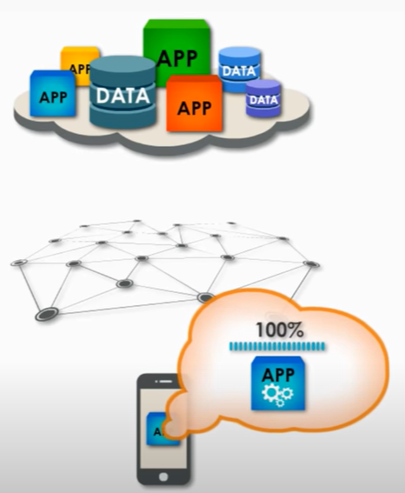
Remote cloud
Remote cloud is the traditional cloud computing for mobile network. Mobile devices, acting as a resource consumer, get rich computing and storage resources provided by remote servers through the mobile network, ensuring OnDemand, scalable and easy access.
Since mobile devices usually need to upload data or to request large amounts of data from the cloud, the remote cloud model may experience high latency, large communication overhead and other shortcomings, which do not apply to real-time application scenarios.

Slide 37
Limitations of Remote Cloud for Mobile Networks
While remote cloud provides scalability and cost efficiency, it has some shortcomings in real-time or latency-sensitive applications:
High Latency – Data must travel from the mobile device to the remote cloud server (often many kilometers away) and back. This round-trip delay can be too high for applications like autonomous driving, AR/VR, and online gaming.
Large Communication Overhead – Mobile devices often need to upload huge datasets (e.g., video streams, sensor data), leading to bandwidth consumption and network congestion.
Unreliable Performance for Real-Time Applications – Applications that require ultra-low latency (e.g., healthcare monitoring, mission-critical IoT) cannot tolerate the delays introduced by remote cloud.

Slide 38
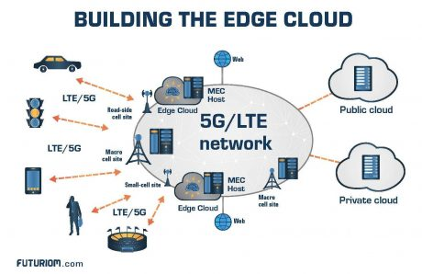
Local cloud
A local cloud (also called a cloudlet) refers to a small-scale data center located close to end users within the 5G network infrastructure.
It is typically made up of a set of interconnected computers or servers deployed at the network edge (e.g., at a base station, access point, or local facility).
These servers provide computing, storage, and application services to mobile devices in close proximity.
Since the cloudlet is physically closer than a remote cloud data center, it offers low latency, reduced communication overhead, and faster response times.

Slide 39
Key Features
Low Latency – Processing happens at the edge, avoiding delays of distant remote clouds.
Support for Mobility – Ideal for users who move frequently, since services are deployed within the network they connect to.
Real-Time Application Support – Enables latency-sensitive applications such as AR/VR, autonomous vehicles, real-time gaming, and smart healthcare monitoring.
Offloading for Resource-Constrained Devices – Mobile devices can offload computation-heavy tasks (like AI inference, video processing) to the local cloudlet.
Comparison with Remote Cloud
Remote Cloud: Centralized, powerful, scalable, but suffers from high latency and network congestion.
Local Cloud: Smaller scale, closer to users, provides faster service with limited capacity compared to remote cloud.

Slide 40
Hybrid cloud
Hybrid Cloud in Mobile Networks
A hybrid cloud combines the strengths of both local cloud (cloudlet) and remote cloud to optimize mobile computing performance.
In this model, a mobile device first offloads tasks to a nearby local cloud for fast processing.
If the task is too computationally intensive or requires large-scale resources, the local cloud can further offload it to the remote cloud, which has virtually unlimited computing and storage capacity.
This creates a multi-layered hierarchy where tasks are executed at the most appropriate level depending on latency, resource demand, and application requirements.
Key Features of Hybrid Cloud
Flexibility – Can balance between local (fast but limited resources) and remote (scalable but higher latency) clouds.
Resource Optimization – Ensures that resource-hungry tasks don’t overload the local cloud.
Seamless Scalability – Local clouds can scale on demand by leveraging remote cloud resources.
Support for Diverse Applications – Real-time tasks handled locally, while data-heavy tasks go to the remote cloud.

Slide 41
5G In Healthcare
The 5G technology is integrated with the healthcare industry to improve patient care. The technology enables remote diagnostics, enhance telemedicine, and increase the efficiency of healthcare operations.
Telemedicine: Offering remote consultations and diagnostics, improving access to care for people in rural or underserved areas.
Remote diagnostics and monitoring: 5G technology can support the transmission of high-resolution medical imaging and real-time data from medical devices. This allows for remote diagnostics and continuous monitoring of patients, potentially leading to faster treatment decisions and better outcomes.

Slide 42
Internet of Medical Things (IoMT): 5G can support a vast number of connected medical devices, which enables real-time monitoring of patients' conditions.
Remote surgery: 5G's low latency and high bandwidth capabilities may enable surgeons to perform telesurgery or remote surgery, using robotic systems controlled from a distance.
AI and big data: The healthcare business may benefit greatly from artificial intelligence and Machine learning. AI can assist in diagnosing illnesses such as cancer, heart disease, skin blemishes, and others. The high-speed data transfer enabled by 5G can support the integration of AI and big data analytics in healthcare, helping providers make more informed decisions, predict health trends, and optimize resource allocation.

Slide 43
Nonorthogonal Multiple Access
Non-Orthogonal Multiple Access (NOMA) is a multiple access technique used in 5G and beyond wireless networks that allows multiple users to share the same time, frequency, and code resources by superimposing their signals with different power levels.
Unlike traditional Orthogonal Multiple Access (OMA) methods (like TDMA, FDMA, or OFDMA), where users are separated in time or frequency to avoid interference, NOMA intentionally allows overlap and uses power-domain multiplexing + advanced decoding (SIC) to separate users.
Advantages of NOMA
High Spectral Efficiency → Multiple users can share the same resources.
Massive Connectivity → Supports more devices (important for IoT and 5G).
User Fairness → Power allocation ensures weak users are not disadvantaged.
Low Latency → Multiple users served simultaneously instead of waiting for separate time slots.

Slide 44
Key Concepts in NOMA
Superposition Coding (SC)
At the transmitter (Base Station), signals for different users are combined (superimposed) with different power allocation coefficients.
Weaker channel users → Higher power.
Stronger channel users → Lower power.
Successive Interference Cancellation (SIC)
At the receiver (User Equipment), each user receives the same composite signal.
Stronger users perform step-by-step decoding, removing signals of weaker users before decoding their own.
Weaker users decode their own signal directly, treating others as interference.
Limitations of NOMA
Receiver Complexity → SIC requires extra processing, especially for users with many interfering signals.
Error Propagation → If SIC decoding fails for one user, errors may propagate to the next stage.
Optimal Power Allocation → Balancing fairness and efficiency is challenging.

Slide 45
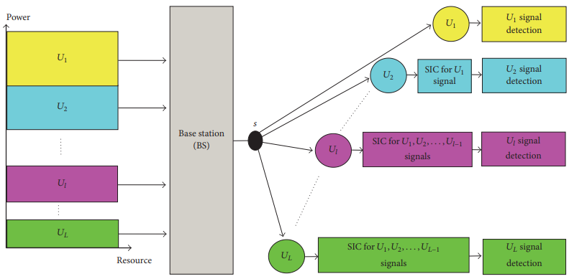
Nonorthogonal Multiple Access
At the transmitter side of downlink NOMA network, as shown in Figure below, the BS transmits the combined signal, which is a superposition of the desired signals of multiple users with different allocated power coefficients, to all mobile users.
At the receiver of each user, successive interference cancellation (SIC) process is assumed to be performed successively until user’s signal is recovered.

Slide 46
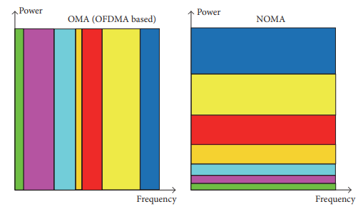
Comparison of OMA and NOMA
In Orthogonal Multiple Access (OMA), such as in OFDMA, a specific frequency resource is assigned to each user even it experiences a good or bad channel condition; thus the overall system suffers from low spectral efficiency and throughput.
In the contrary, in NOMA the same frequency resource is assigned to multiple mobile users, with good and bad channel conditions, at the same time. Hence, the resource assigned for the weak user is also used by the strong user, and the interference can be mitigated through SIC processes at users’ receivers.
Therefore, the probability of having improved spectral efficiency and a high throughput will be considerably increased as depicted in Figure below.

Slide 47
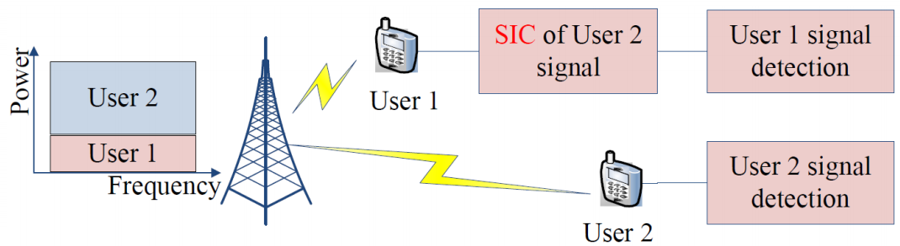
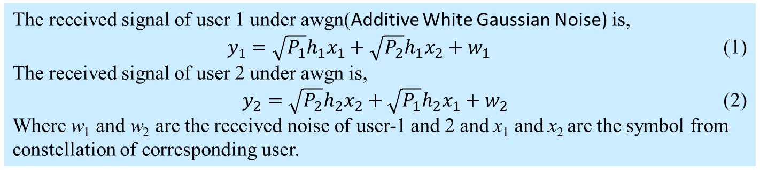
Two users are served at the same time, frequency and code, where the transmit power for user 1 and 2 are P₁ and P₂ respectively and corresponding channel gains are h₁ and h₂. Here user-1 is near user needs less transmit power from BS P₁< P₂ and has higher channel gain h₁>h₂.
The received signal of user 1 under awgn(Additive White Gaussian Noise) is,
$y1=\sqrt{P_{1}}h_{1}x_{1}+\sqrt{P_{2}}h_{1}x_{2}+w_{1}$ (1)
The received signal of user 2 under awgn is,
$y_{2}=\sqrt{P_{2}}h_{2}x_{2}+\sqrt{P_{1}}h_{2}x_{1}+w_{2}$ (2)
Where w₁ and w₂ are the received noise of user-1 and 2 and x₁ and x₂ are the symbol from constellation of corresponding user.

Slide 48
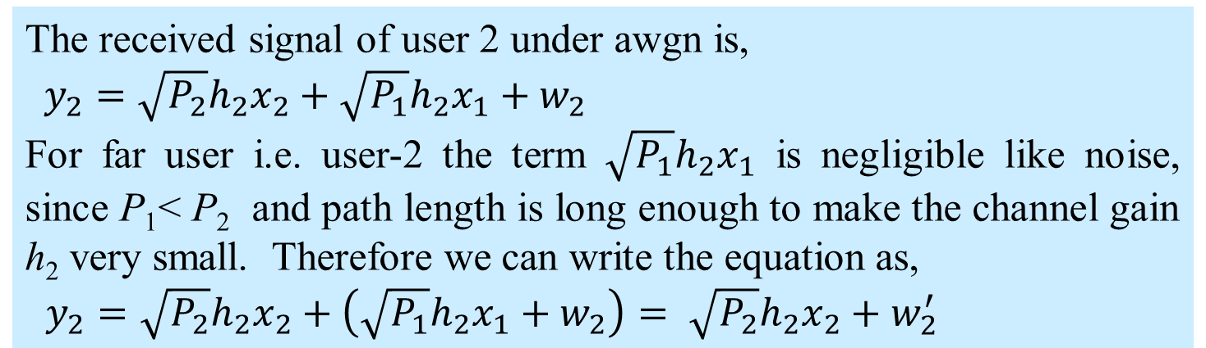
The received signal of user 2 under awgn is,
$y_{2}=\sqrt{P_{2}}h_{2}x_{2}+\sqrt{P_{1}}h_{2}x_{1}+w_{2}$
For far user i.e. user-2 the term $\sqrt{P_{1}}h_{2}x_{1}$ is negligible like noise, since P₁< P₂ and path length is long enough to make the channel gain h₂ very small. Therefore we can write the equation as,
$y_{2}=\sqrt{P_{2}}h_{2}x_{2}+\left(\sqrt{P_{1}}h_{2}x_{1}+w_{2}\right)= \sqrt{P_{2}}h_{2}x_{2}+w_{2}^{′}$

Slide 49
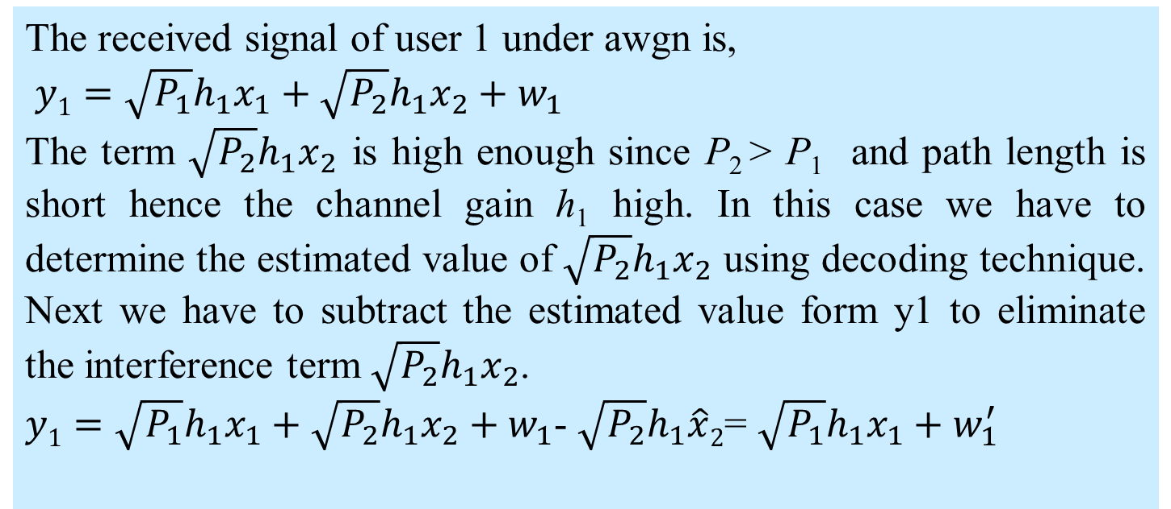
The received signal of user 1 under awgn is,
$y1=\sqrt{P_{1}}h_{1}x_{1}+\sqrt{P_{2}}h_{1}x_{2}+w_{1}$
The term $\sqrt{P_{2}}h_{1}x_{2}$ is high enough since P₂ > P₁ and path length is short hence the channel gain h₁ high. In this case we have to determine the estimated value of $\sqrt{P_{2}}h_{1}x_{2}$ using decoding technique. Next we have to subtract the estimated value form y1 to eliminate the interference term $\sqrt{P_{2}}h_{1}x_{2}$.
$y1=\sqrt{P_{1}}h_{1}x_{1}+\sqrt{P_{2}}h_{1}x_{2}+w_{1}$- $\sqrt{P_{2}}h_{1}\hat{x}2$= $\sqrt{P_{1}}h_{1}x_{1}+w_{1}^{′}$

Slide 50
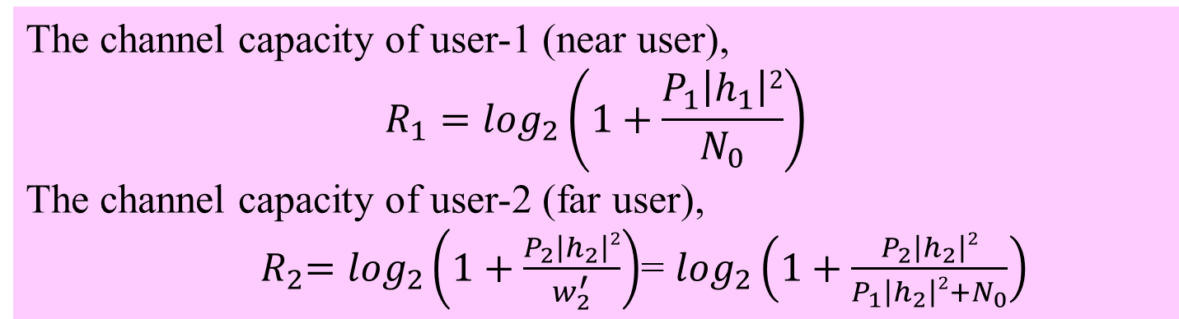
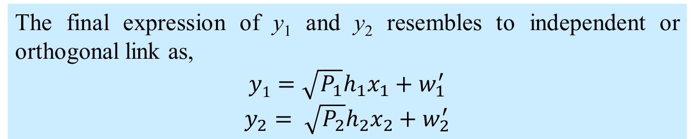
The final expression of y₁ and y₂ resembles to independent or orthogonal link as,
$$y1=\sqrt{P_{1}}h_{1}x_{1}+w_{1}^{′}$$
$$y_{2}= \sqrt{P_{2}}h_{2}x_{2}+w_{2}^{′}$$
The channel capacity of user-1 (near user),
$$R_{1}=\log_{2}\left(1+\frac{P_{1}\left|h_{1}\right|2}{N_{0}}\right)$$
The channel capacity of user-2 (far user),
${ R}_{2}=\log_{2}\left(1+\frac{P_{2}\left|h_{2}\right|2}{w_{2}^{′}}\right)$= $\log_{2}\left(1+\frac{P_{2}\left|h_{2}\right|2}{P_{1}\left|h_{2}\right|2+N_{0}}\right)$

Slide 51
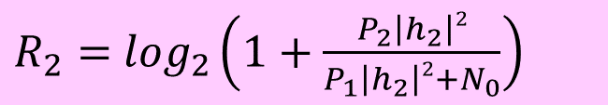
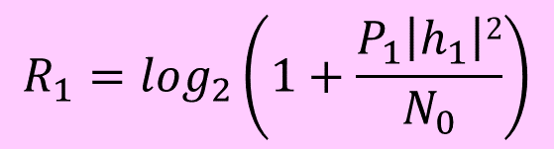
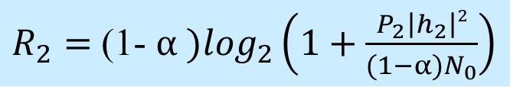
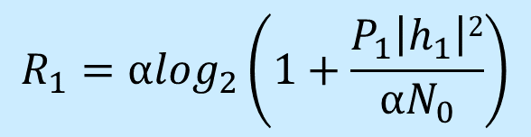
Non-orthogonal scheme
$$R_{1}=\log_{2}\left(1+\frac{P_{1}\left|h_{1}\right|2}{N_{0}}\right)$$
bits/s/Hz
$R_{2}=$ $\log_{2}\left(1+\frac{P_{2}\left|h_{2}\right|2}{P_{1}\left|h_{2}\right|2+N_{0}}\right)$
bits/s/Hz
Orthogonal scheme
$$R_{1}={αlog}_{2}\left(1+\frac{P_{1}\left|h_{1}\right|2}{{αN}_{0}}\right)$$
bits/s/Hz
$R_{2}=$ (1- $α )\log_{2}\left(1+\frac{P_{2}\left|h_{2}\right|2}{(1−α)N_{0}}\right)$
bits/s/Hz
α represents the fraction of the bandwidth devoted to user 1

Slide 52

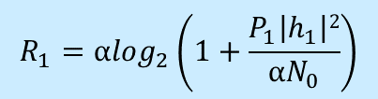

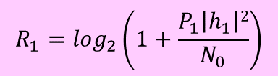
Rate of user 1 (R₁)
R_{1_max}
Nonorthogonal scheme
$$R_{1}=\log_{2}\left(1+\frac{P_{1}\left|h_{1}\right|2}{N_{0}}\right)$$
bits/s/Hz
$R_{2}=$ $\log_{2}\left(1+\frac{P_{2}\left|h_{2}\right|2}{P_{1}\left|h_{2}\right|2+N_{0}}\right)$
bits/s/Hz
Orthogonal scheme
$R_{2}=$ (1- $α )\log_{2}\left(1+\frac{P_{2}\left|h_{2}\right|2}{(1−α)N_{0}}\right)$
$$R_{1}={αlog}_{2}\left(1+\frac{P_{1}\left|h_{1}\right|2}{{αN}_{0}}\right)$$
R_{2_max}
Rate of user 2 (R₂)
α represents the fraction of the bandwidth devoted to user 1.
This figure illustrates the achievable rate regions of two users (user 1 and user 2) in a multiple access system, comparing Orthogonal Multiple Access (OMA) and Non-Orthogonal Multiple Access (NOMA) schemes.

Slide 53
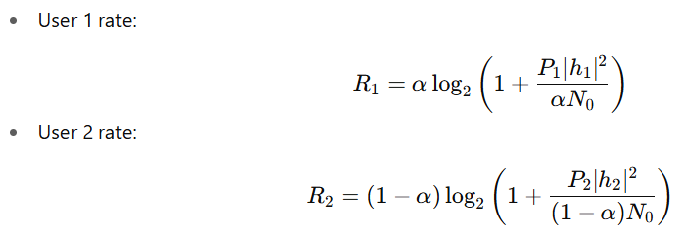
Orthogonal scheme (OMA)
In OMA (e.g., TDMA or FDMA), the total bandwidth is divided between the two users:
where:
α is the fraction of bandwidth allocated to user 1 (hence 1−α for user 2).
Pi​ is transmit power for user i.
∣hi​∣2 is the channel gain.
N0​ is noise power.
The OMA achievable region is represented by the blue dashed line, which is linear and limited.

Slide 54
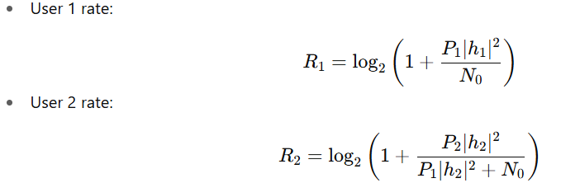
Non-Orthogonal scheme (NOMA)
In NOMA, both users share the same bandwidth simultaneously, with power-domain multiplexing. Successive interference cancellation (SIC) is used at the receiver:
This forms the curved green boundary, which covers a larger achievable rate region compared to OMA.
Key Points
OMA (blue line): rate tradeoff is strictly linear, limited by bandwidth split.
NOMA (green curve): rate tradeoff is more flexible and generally provides a larger achievable region, allowing better spectral efficiency.
α: controls how much bandwidth goes to user 1 in OMA.
NOMA advantage: Users can simultaneously use the full bandwidth, achieving higher sum rates.

Slide 55
5G Architecture

Slide 56
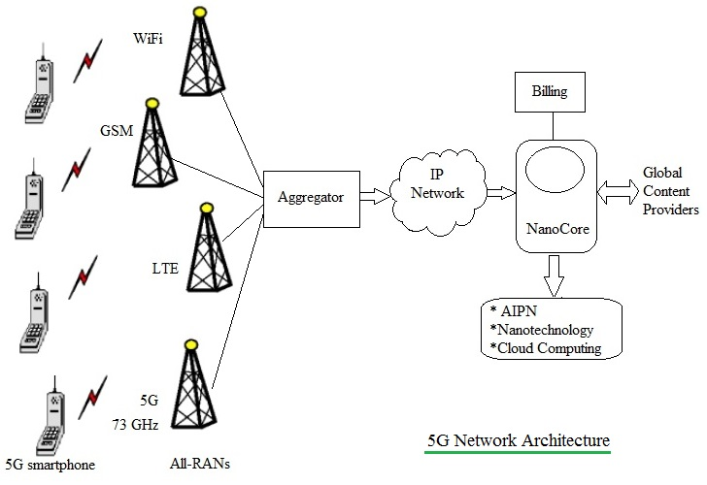
Figure below depicts the generic architecture of 5G network. As shown 5G network uses flat IP concept so that different RANs (Radio Access Networks: GSM, GPRS/EDGE, UMTS, LTE, LTE-advanced, WiMAX, WiFi, CDMA2000, EV-DO, CDMA One, IS-95 etc.) can use the same single Nanocore for communication.
5G aggregator aggregates all the RAN traffics and route it to gateway.
5G aggregator is located at BSC/RNC place.
It consists of nanotechnology, cloud computing, All IP architecture.

Slide 57
5G Generic Architecture Overview
Flat IP Concept:
The Flat IP architecture is a network design principle where all network entities (devices, servers, applications) are directly connected over a single IP-based backbone, instead of using multiple hierarchical layers (like in 2G/3G).
Unlike hierarchical architectures in 2G/3G/4G, 5G adopts a flat, all-IP architecture. This minimizes intermediate nodes, reduces latency, and enables faster, more direct connections between end-users and services.
Multi-RAN Support: The 5G core (nanocore) is designed to interoperate with various existing and emerging Radio Access Technologies (RATs), including:
Legacy RANs: GSM, GPRS/EDGE, UMTS, CDMA, IS-95
4G/Enhanced RANs: LTE, LTE-Advanced, WiMAX
Next-gen RANs: Wi-Fi (for unlicensed access), 5G NR (New Radio)

Slide 58
Nanocore: The single nanocore (IP-based core) acts as a unified backbone for all these RANs.
It ensures seamless mobility across heterogeneous networks.
Supports QoS-aware services (voice, video, IoT, AR/VR, etc.).
Provides network slicing for different applications and industries.
Key Features:
Seamless Handover: Users can move across LTE, Wi-Fi, or 5G NR without losing session continuity.
Interoperability: Common IP-based protocol stack allows backward compatibility.
Flexibility: New RANs can be integrated without redesigning the entire core.
Reduced Latency: Flat design reduces hops between user and service provider.

Slide 59
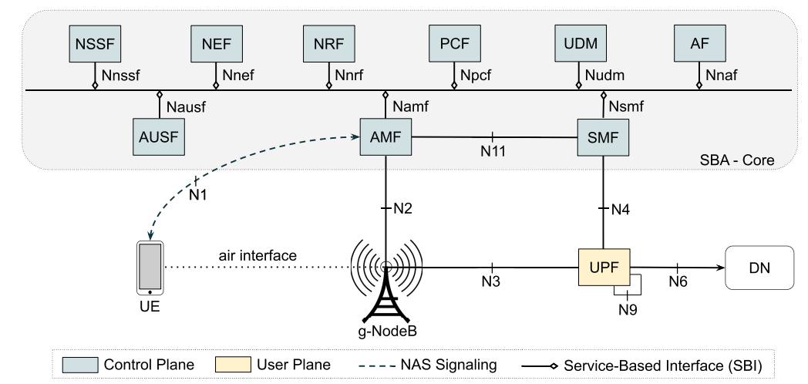
Basically, the 5G consists of Radio Access Network (RAN) and Core Network (CN).
Access and Mobility Management Function (AMF):
Responsible for subscriber registration (new user after inserting SIM first), mobility management, access authentication and authorization. It catching the subscribers’ physical locations and handling the signal handover between two cellular towers within the RAN.
The AMF has some of the functions of the MME of 4G.

Slide 60
Session Management Function (SMF):
To setup of the connectivity for the UE towards Data Networks (Internet) like P-GW of LTE-A.
It manages the user sessions including establishment, modification and release of sessions.

Slide 61
It can allocate IP addresses for IP PDU sessions (static or DHCP)
Configures traffic steering (design traffic path) at UPF to route traffic to proper destination;
Its function is like MME and P-GW of LTE.
What is a Session in 5G?
A session in mobile networks is simply the logical connection between a user device (UE) and a data network (DN) (like the Internet, enterprise cloud, or operator services).
In 5G, this is called a PDU Session.
PDU = Protocol Data Unit, meaning the type of data the session carries (IP packets, Ethernet frames, or unstructured data).

Slide 62
User Plane Function (UPF): Responsible for creating tunnels between the subscribers and the data network (DN), as per the SMF’s instructions. The UPF has some of functions of the 4G EPC SGW and PGW
Packet routing & forwarding
Redirection, Traffic steering.
QoS handling

Slide 63
Authentication Server Function (AUSF):
Responsible for authenticating subscribers and providing encryption keys to the appropriate entities. It works like HSS of LTE.

Slide 64
Network Exposure Function (NEF):
It deals with interface between 5G core and non 3GPP network. It can be thought of as a proxy, or Application Programming Interface (API) aggregation point, or translator into the 5G Core Network.

Slide 65
What is a Network Slice in 5G?
A network slice is a virtual and independent logical network built on top of the common physical 5G infrastructure.
Each slice behaves like a dedicated network, even though they all share the same hardware (antennas, base stations, servers, transport links).
Each slice is designed with specific QoS (Quality of Service), latency, bandwidth, and reliability requirements to serve different types of applications.

Slide 66
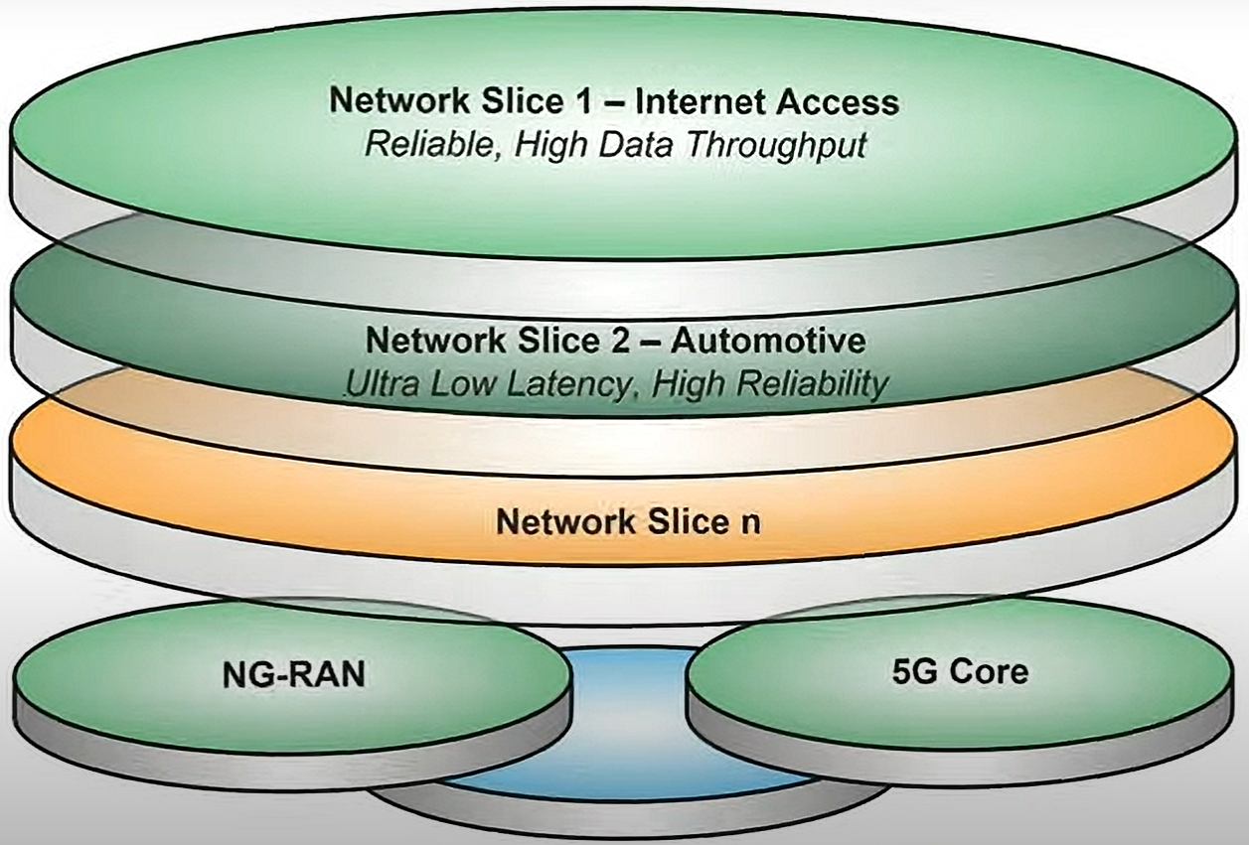
NSSF (Network Slicing Selection Function):
In 5G network several virtual and independent logical networks are built on the common physical infrastructure of the network. This seems to be equivalent to the multiplexing several independent logical network, where each of the virtual network service or slice has different application with different QoS.

Slide 67
For example in M2M communication in industry is a slice has the attribute of low latency. Some of the use cases of 5G network slicing are: Gaming, 5G surgery, IoT slices etc.
Next‐generation radio access network (NG‐RAN)
Policy Control Function (PCF): Responsible for providing subscription policy rules to AMF and SMF. The PCF has some of the functions of the 4G EPC PCRF.

Slide 68
The PCF is responsible for managing and providing policy rules that govern how network resources are allocated and how user sessions are handled in a 5G network.
Essentially, it decides “who can do what, and under what conditions” in the network.
Functions include:
Providing subscription-based policies to other network functions such as:
AMF (Access and Mobility Management Function) – for mobility and access control.
SMF (Session Management Function) – for session management and QoS enforcement.
Enforcing Quality of Service (QoS) rules for user sessions.
Charging and usage control support.
Dynamic policy updates based on network conditions or user subscriptions.

